Slide 1
Mining Social Networks
Uncovering interaction patterns in business processes
Prof.dr.ir. Wil van der Aalst
Eindhoven University of Technology
Department of Information and Technology
P.O. Box 513, 5600 MB Eindhoven
The Netherlands
w.m.p.v.d.aalst@tm.tue.nl
Joint work with Minseok Song, Ana Karla Alves de Medeiros, Boudewijn van Dongen, Ton Weijters, et al.

Slide 2

Outline
Motivation
Process mining
  Overview
  Classification
  Tooling
Social network analysis
Metrics
MiSoN
Application
Conclusion

Slide 3
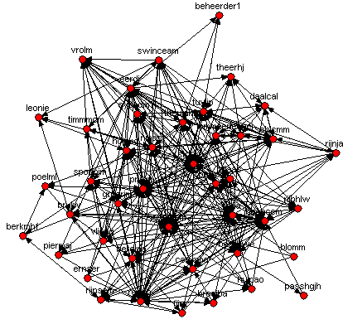
Motivation
Process-aware information systems (WFMS, BPMS, ERP, SCM, B2B) log events.
Many event logs also record the “performer”.
Social Network Analysis (SNA) started in the 30-ties (Moreno) and resulted in mature methods and tools for analyzing social networks.
Process Mining (PM) is a new technique to extract knowledge from event logs.
Research question: Can we combine SNA and PM?

Slide 4


Slide 5

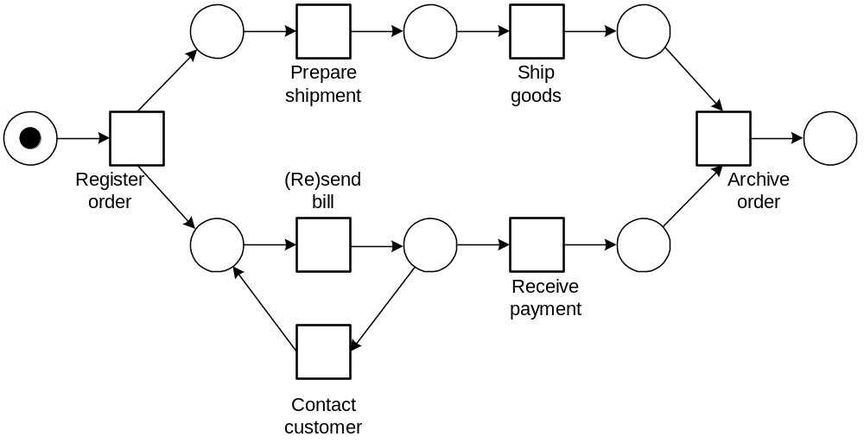
Process mining
process
mining
Process mining can be used for:
  Process discovery (What is the process?)
  Delta analysis (Are we doing what was specified?)
  Performance analysis (How can we improve?)
www.processmining.org

Slide 6


Slide 7
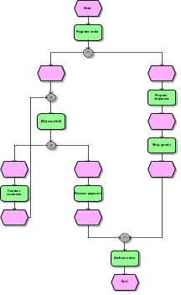
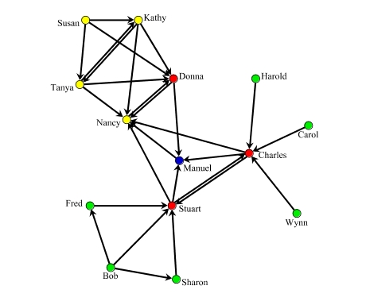
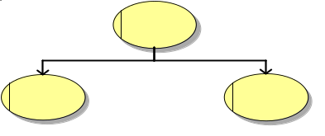



Process mining: Overview
2) process model
3) organizational model
4) social network
1) basic performance metrics
5) performance characteristics
6) auditing/security
If …then …

Slide 8
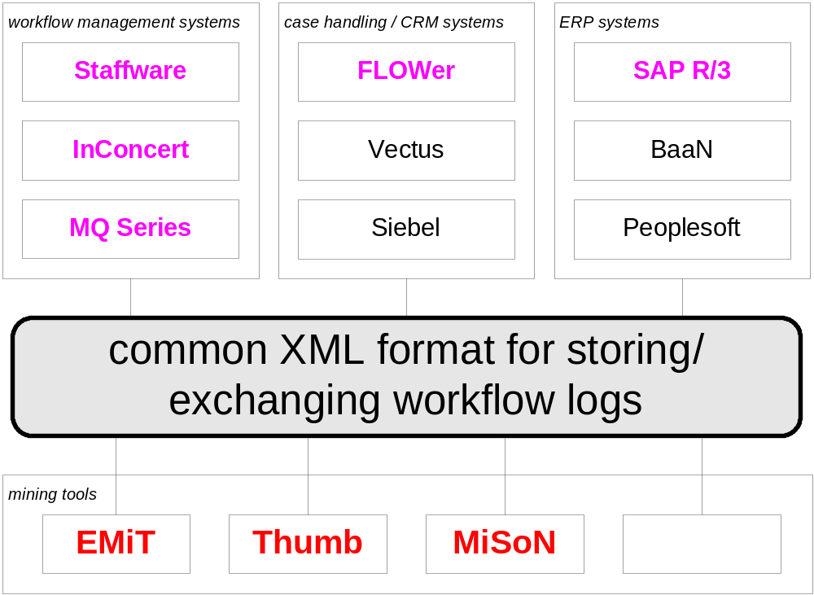
Process Mining: Tooling

Slide 9
Social Network Analysis
Started in 30-ties (Moreno).
Graph where nodes indicate actors (performers/individuals).
Edges link actors and may be directed and/or weighted.
Metrics for the graph as a whole:
  density
Metrics for actors:
  Centrality (shortest path/path through)
  Closeness (1/sum of distances)
  Betweenness (paths through)
  Sociometric status (in/out)
Mary
John
Bob
Clare
June

Slide 10
Metrics
Each event refers to a case, a task and a performer (event type, data, and time are optional).
Four types of metrics:
  Metrics based on (possible) causality
  Metrics based on joint cases
  Metrics based on joint activities
  Metrics based on special event types

Slide 11


Example: Metrics based on (possible) causality
Hand-over of work metrics
In-between metrics
(subcontracting)

Slide 12
Hand-over of work metrics: Parameters
Real causality or not?
Consider hand-overs that are indirect?
(If so, add causality fall factor.)
Consider multiple transfers within one case?
Note that there are at least 8 variants.

Slide 13
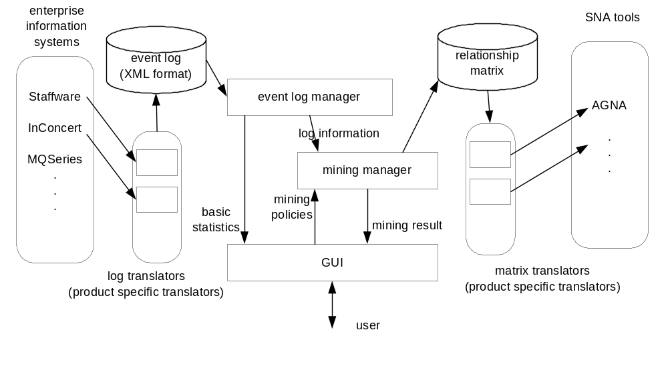
MiSoN (Mining Social Networks) tool
Uses standard XML format (www.processmining.org)
Adapters for Staffware, FLOWer, MQSeries, ARIS, etc.
Interfaces with SNA tools like AGNA, NetMiner, etc.

Slide 14
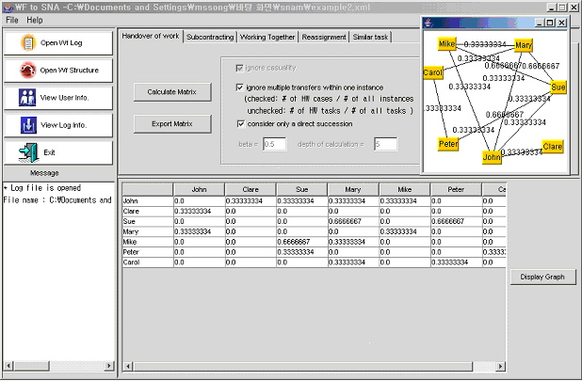
Screenshot
types of metrics
graph view
matrix view
Real analysis in SNA tools
operations
supported

Slide 15
Case study
Only preliminary results
Dutch national works department (1000 workers)
Responsible for construction and maintenance of infrastructure in province.
Process: Processing of invoices from the various subcontractors and suppliers
Log: 5000 cases and 33.000 events.
Focus on 43 key players

Slide 16
SN based on hand-over of work metric
density of network is 0.225

Slide 17
Ranking of performers
Ranking
Name
Betweenness
Name
IN-Closeness
Name
OUT-Closeness
Name
Power
1
rogsp
0.152
rogsp
0.792
jansgtam
0.678
bechccm
4.102
2
bechccm
0.141
bechccm
0.792
rogsp
0.667
rogsp
2.424
3
jansgtam
0.085
prijlgm
0.75
bechccm
0.656
hulpao
1.964
4
eerdj
0.079
jansgtam
0.689
eerdj
0.635
groorjm
1.957
5
prijlgm
0.065
frida
0.667
schicmm
0.625
hopmc
1.774
…
…
…
…
…
…
…
…
…
39
ernser,
broeiba,
fijnc,
hulpao,
blomm,
berkmhf,
piermaj,
passhgjh,
beheerder1
0
blomm
0
berkmhf
0.381
passhgjh
0.001
40
passhgjh
0.331
timmmcm
0.385
beheerder1
0.005
41
piermaj
0.375
passhgjh
0.404
poelml
0.007
42
fijnc
0.382
fijnc
0.417
berkmhf
0.007
43
berkmhf
0.382
leonie
0.426
timmmcm
0.009

Slide 18
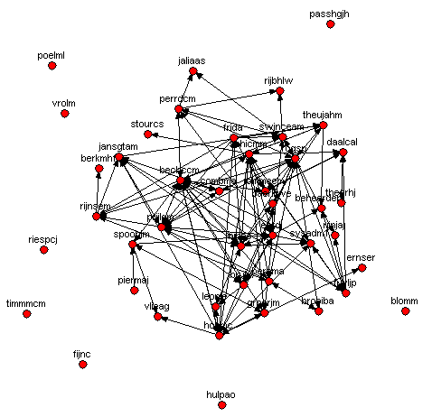
SN based on subcontracting

Slide 19
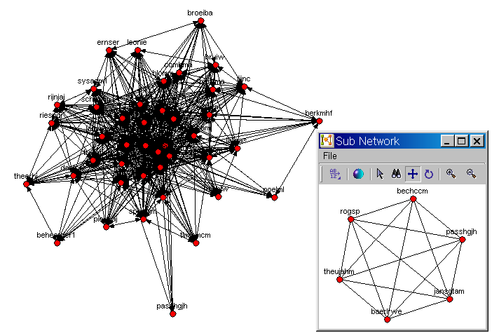
SN based on working together (and ego network)

Slide 20
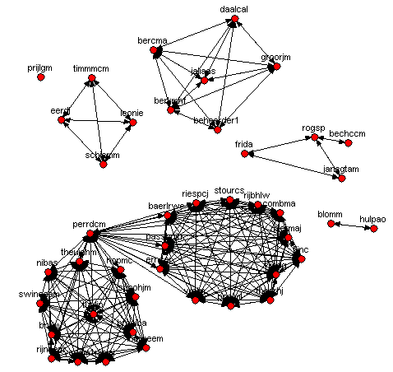
SN based on joint activities

Slide 21
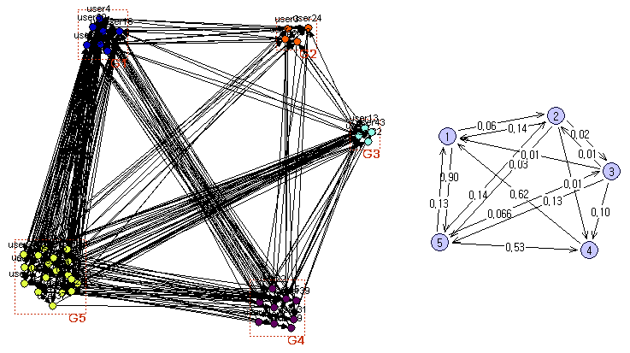
SN based on hand-over of work between groups

Slide 22
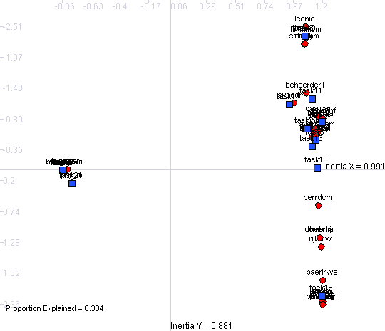
Relating tasks and performers
(using correspondence analysis)

Slide 23

Conclusion
Combining process mining and SNA provides interesting results.
MiSoN enables the application of SNA tools based on “objective data”.
There are many challenges:
  Applying PM/SNA in organizations
  Improving the algorithms (hidden/duplicate tasks, …)
  Gathering the data
  Visualizing the results
  Etc.
Join us at www.processmining.org

Slide 24
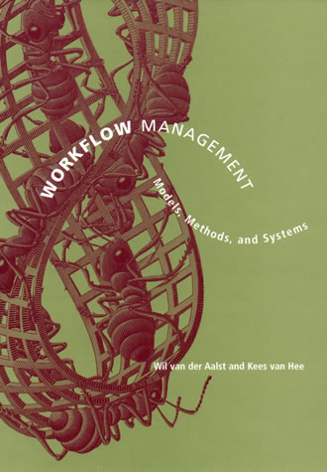
More information
http://www.workflowcourse.com
http://www.workflowpatterns.com
http://www.processmining.org
  W.M.P. van der Aalst and K.M. van Hee.
  Workflow Management: Models, Methods, and Systems.
  MIT press, Cambridge, MA, 2002/2004.

